Slide 2
WELCOME TO THE WORLD OF TECHNOLOGY
error 404

Slide 3
introducing

Slide 4
x

Slide 5
x
hyper_x
step towaRDS a new feature

Slide 6
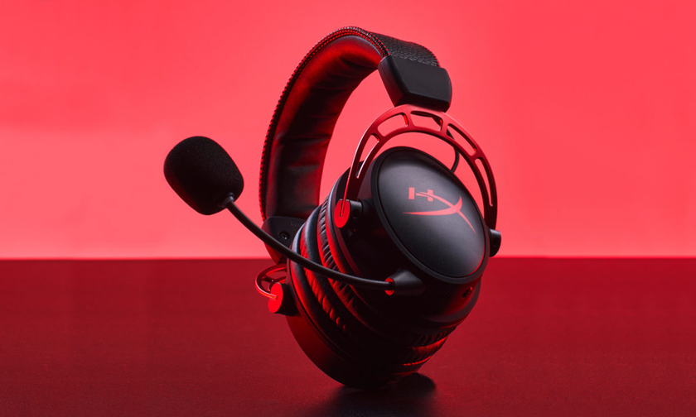
HYPER X cloud alpha

Slide 7
The super exclusive headphones for
better gaming experience
HYPER X cloud alpha

Slide 8
The super exclusive headphones for
better gaming experience
About this item
HyperX Dual chamber drivers for more distinction and less distortion
Signature award-winning HyperX comfort, Type: Circumaural, closed back
Durable aluminium frame with expanded headband
Detachable braided cable with convenient in-line audio control, detachable noise cancellation microphone. Impedance: 65 Ω
Microphone Frequency response: 50Hz-18,000Hz
HyperX Dual chamber drivers for more distinction and less distortion
Signature award-winning HyperX comfort, Type: Circumaural, closed back
Durable aluminium frame with expanded headband
Detachable braided cable with convenient in-line audio control, detachable noise cancellation microphone. Impedance: 65 Ω; Microphone Frequency response: 50Hz-18,000Hz
Warranty Description: 2 Years
HYPER X cloud alpha
price - ₹12,999
available on the offi cial store as well
as other shopping platforms

Slide 9

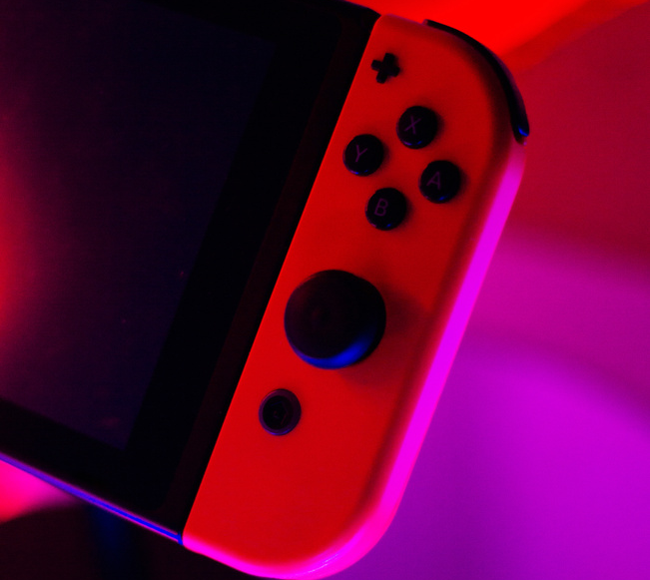
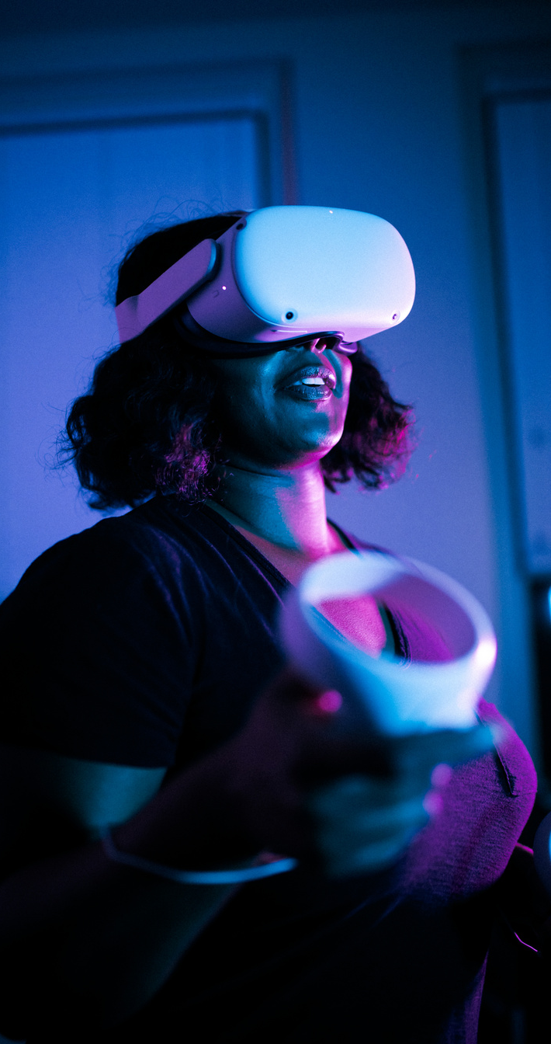

Executive Summary
BACK TO
NAVIGATION PAGE
Company Overview
Company Vision
Founded as a self-run business in 2002, the company has steadily expanded until it achieved its current national reach.
To expand our reach
to a global scale
and to ultimately
help in consolidating
the industry.
Current Market Position
The company has recently been rated
as one of the top ten best-performing businesses in the sector.

Slide 10
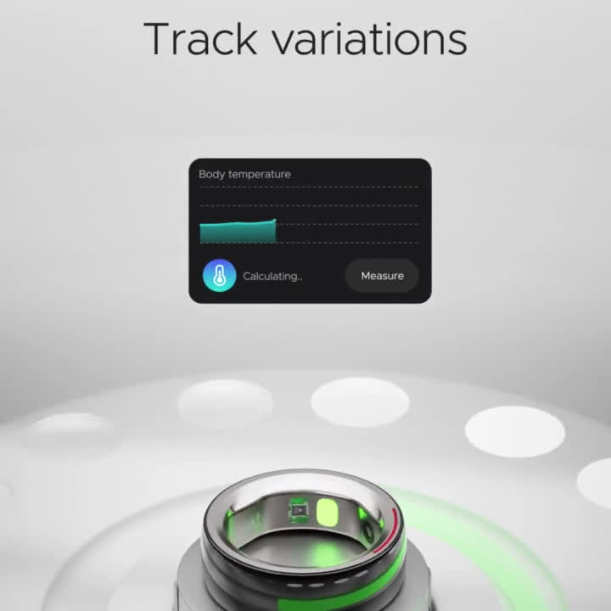

Slide 11
